Slide 1
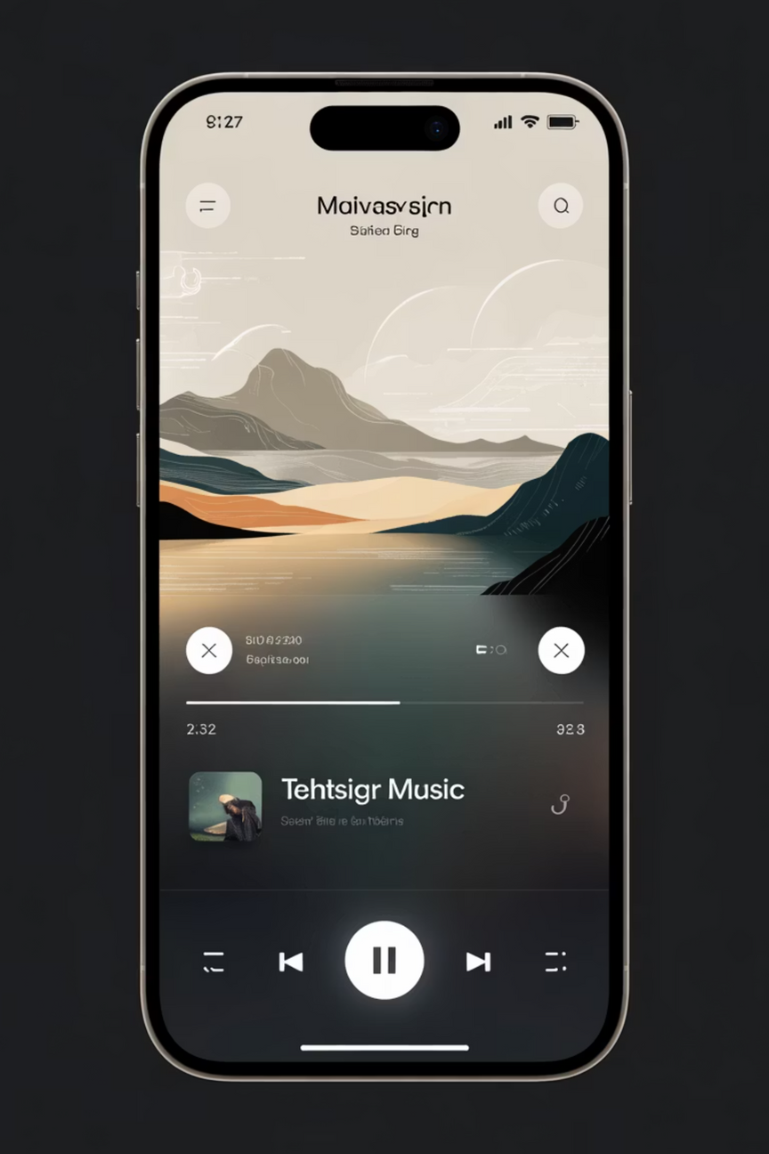

Personalized Music Discovery & Playlist Curation App
UI/UX Case Study: Designing an Emotion-Aware Listening Experience
In today’s vast digital landscape, users often struggle to find music that truly matches their current mood or activity. This project focuses on designing an AI-driven music application that transforms the user experience through hyper-personalized, context-aware recommendations and effortless playlist management.

Slide 2
The Problem: Lost in the Sound Library
Repetitive Recommendations
Existing platforms often surface the same artists or genres, leading to listener fatigue and limiting true discovery.
Complex Curation
Users spend too much manual time creating and refining playlists instead of simply enjoying the music.
Limited Discovery
A lack of emotional awareness in algorithms means users miss out on niche, new, or trending tracks that fit their momentary context.
Our goal was to design a smart music discovery experience that seamlessly adapts to user moods, listening habits, and real-time context, making playlist curation effortless and highly engaging.

Slide 3
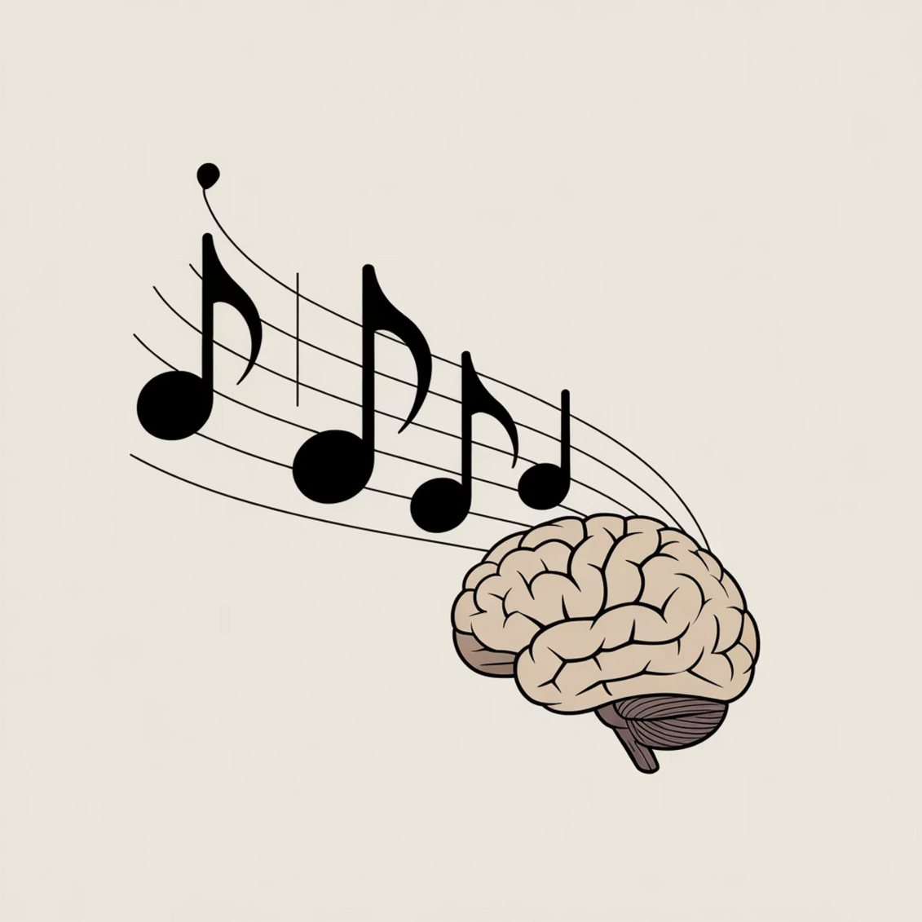
Project Objectives & Scope
Core Design Goals
Deliver personalized song and playlist recommendations based on mood, activity, and history.
Enable smart playlist creation using AI-driven preferences and behavioral patterns.
Simplify playlist editing and management with intuitive, frictionless interactions.
Promote discovery of new artists and trending music through engaging visual content.

Slide 4





Research Methods & Tools
Figma
Adobe XD
Used for high-fidelity UI design, component library creation, and interactive prototyping.
Utilized for creating detailed UI mockups and advanced interaction flows.
Miro
Maze / Useberry
The platform for collaborative brainstorming sessions and comprehensive user flow mapping.
Essential for remote usability testing, heatmaps, and collecting quantitative feedback.
Our methodology combined quantitative data (surveys) with qualitative feedback (interviews) to build a robust, user-centered solution.

Slide 5


Key User Research Insights
73%
61%
54%
Recommendations Repetitive
Need for Mood/Activity Match
Playlist Management Confusion
The majority of users reported feeling stuck in a music "loop" with existing streaming services.
A significant percentage desired playlists that automatically align with their current emotional state or task (e.g., focus, workout, relax).
Users found existing tools for editing, organizing, and discovering new tracks within playlists cumbersome.

Slide 6




The Double Diamond Design Process
We structured the project using the Double Diamond model to ensure comprehensive problem definition and solution refinement.
1. Discover
2. Define
Understand user pain points and identify the core unmet needs in music discovery.
Frame the core problem: How to intelligently curate music based on mood and activity?
3. Develop
4. Deliver
Ideate, wireframe, prototype interactive features like the Mood Selector and Smart Playlist Builder.
Conduct rigorous usability testing, refine the interface, and finalize the high-fidelity design.

Slide 7
Information Architecture & Key Features
1
2
3
Mood Selector Integration
AI-Driven Home Feed
Smart Playlist Builder
A personalized dashboard featuring dynamically generated playlists and tracks that adapt based on time of day and recent listening habits.
One-tap features like "Add Similar Songs" and "Auto-Fill with Trending Tracks" dramatically reduce manual curation time.
Allows instant filtering of the entire library based on the user's current emotional context or planned activity (e.g., Focus, Energy, Calm).
Primary Navigation: Home, Discover, Mood Selector, Playlist, Profile. This architecture prioritizes personalization and ease of access to context-specific music.

Slide 8
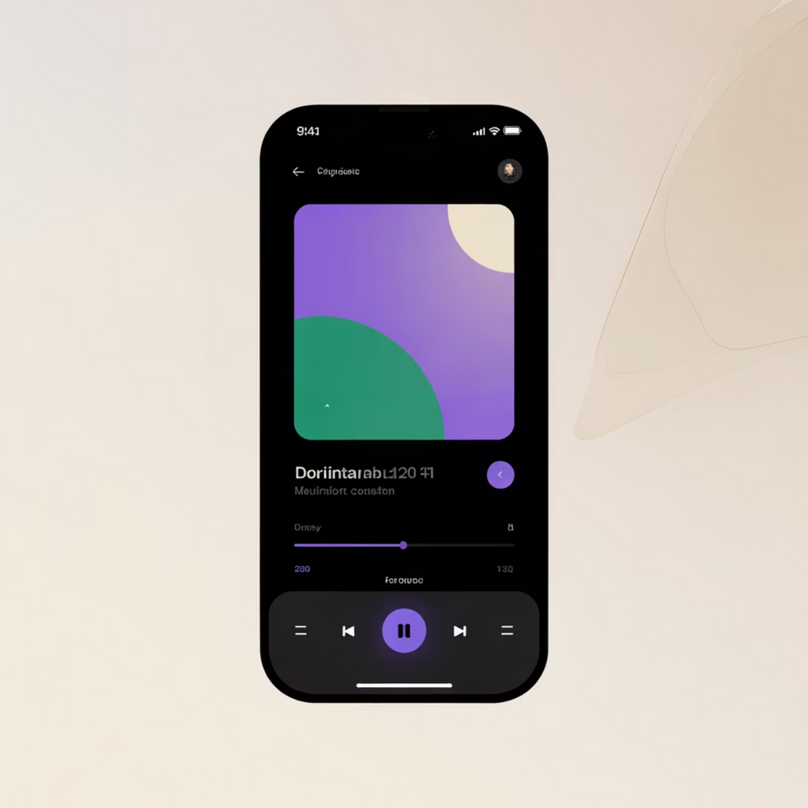
Visual Design System
Color & Typography
The application uses a dark mode interface to enhance focus and contrast. We chose Poppins for its clean, modern readability.
Primary Color
Violet (#6C63FF) - Used for calls-to-action and primary emphasis.
Accent Color
Green (#1DB954) - Highlighting success states and new discovery.
Background
Dark (#121212) - Creates a sophisticated, immersive listening environment.
UI Style
Dark mode with smooth, legible gradients.
Rounded buttons and elements for a friendly, modern feel.
Subtle motion to guide user attention on the Now Playing screen.

Slide 9



Usability Testing Results & Outcomes
We tested the interactive prototype with 10 frequent music listeners to validate the core features.
96%
35s
4.8/5
Task Success Rate
Average Task Time
User Satisfaction Rating
Users successfully navigated the Mood Selector and created a playlist with recommended songs.
Demonstrated the efficiency of the smart playlist features compared to existing platforms.
Users praised the intuitive UI and the relevance of the mood-based song suggestions.
Key Takeaways
The high-fidelity prototype successfully delivered on the project goals, significantly improving playlist curation ease and enhancing the enjoyment of the music listening experience. Engagement metrics showed strong potential for increased session length.

Slide 10




Future Enhancements & Conclusion
The next generation of music discovery will be entirely contextual and collaborative.
AI Mood Detection
Collaborative Playlists
Voice Command Support
Integrate AI using device camera or voice tone for real-time, automatic mood-based playlist changes.
Allow friends to contribute and discover music together in a shared listening session.
Enable hands-free playlist creation and song queuing through natural language processing.

